Slide 1

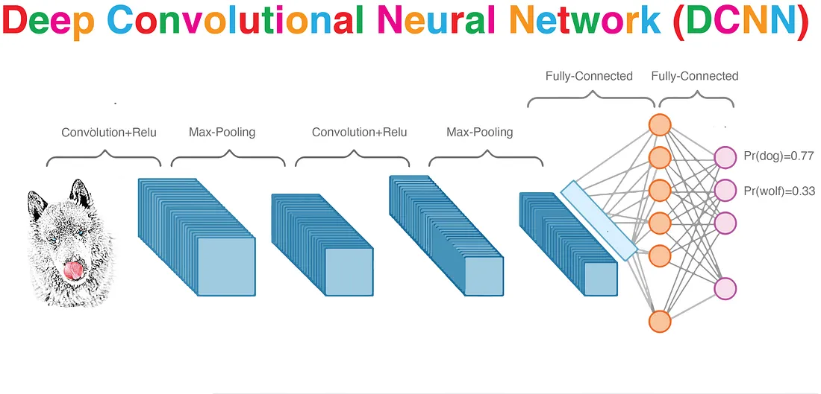
Image Recognition with Deep Learning Tyler Ward
Image credit: Mark Nielsen[15], Shesh Narayan Gupta [18]

Slide 2


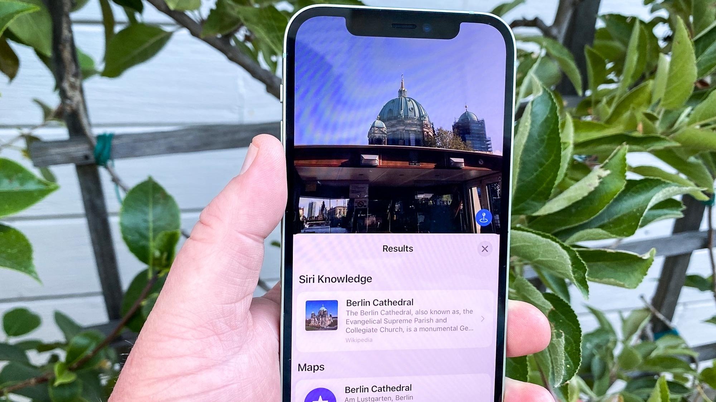
Why develop image recognition?
Image credit: Wikipedia [19], Tom's Guide [20]
Security Access (Face ID, identity recognition)
Reverse Search/Image look up
Object detection (healthcare, defense)

Slide 3
Why use deep learning (complex neural networks)?
Are very flexible, and can create structure from seemingly unstructured data
Can learn unique features of an image, and remember them without need for retraining
Only get better as more data becomes available

Slide 4
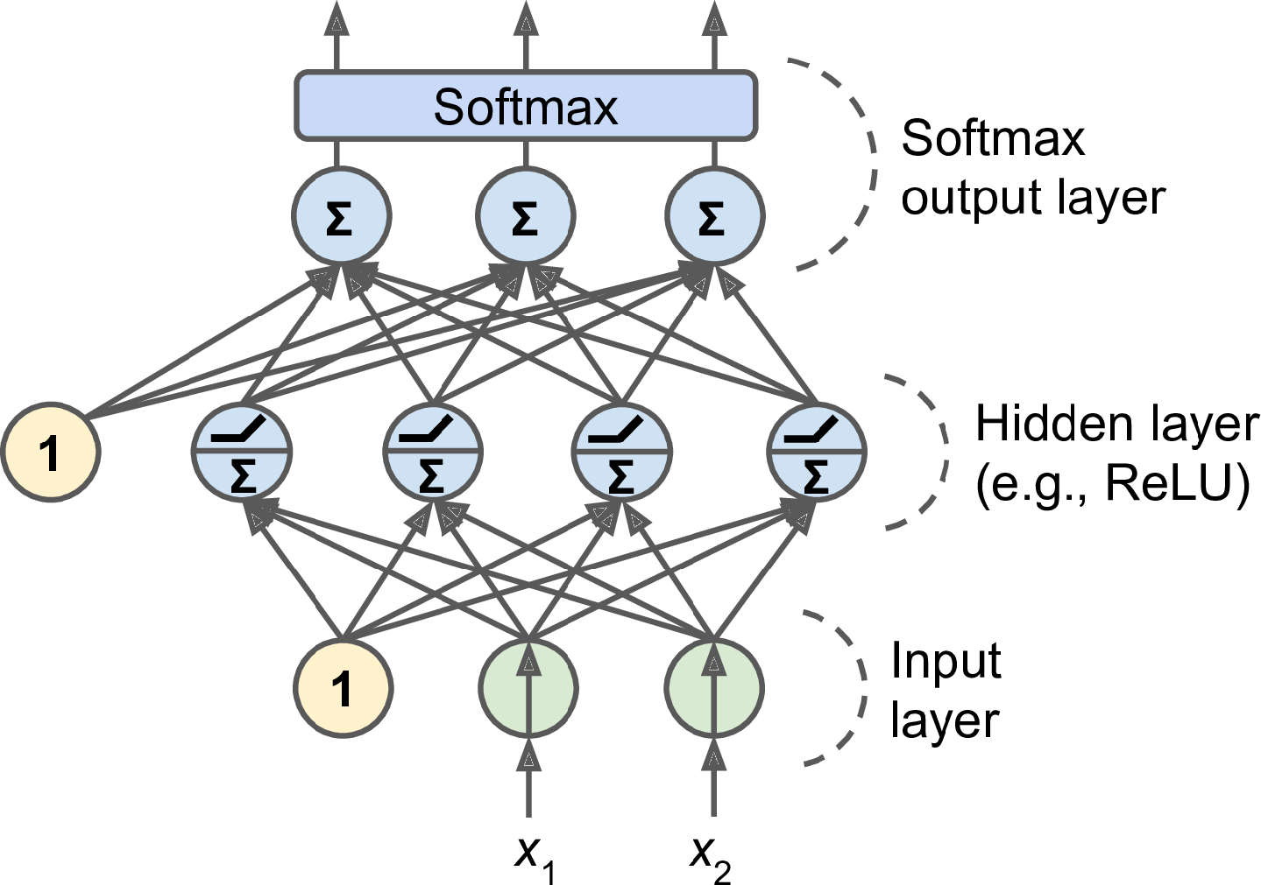
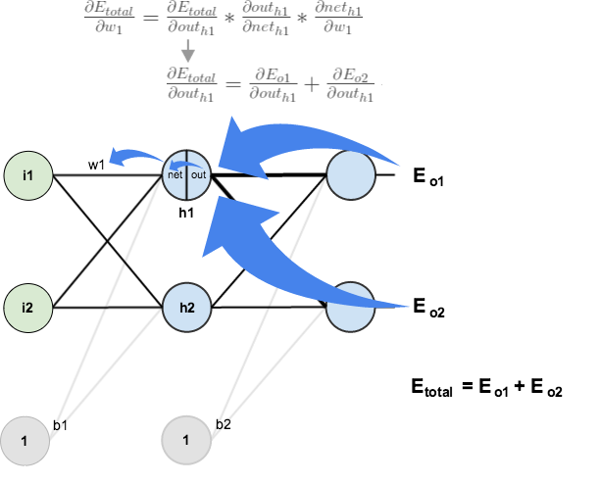
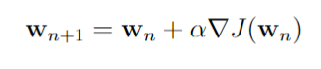
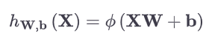
How: Basic Neural Networks
Feed Forward
Chain Rule Back
Gradient Descent
0.5
1.9
AKA Back Propagation [13]
Hidden layer value = activation function(inputs*weights + bias)[7]

Slide 5

Detailed Feature Extraction: Convolutional Neural Networks
Convolutional and pooling layers learn unique features in the spatial structure of images
If using these features reduced in-sample error, they continue to be searched through in subsequent iterations

Slide 6
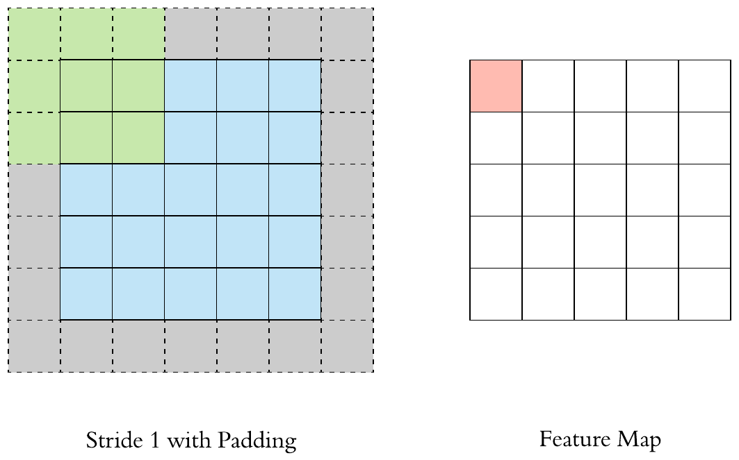
Convolutions and pooling help learn unique features just like our brain!

Slide 7
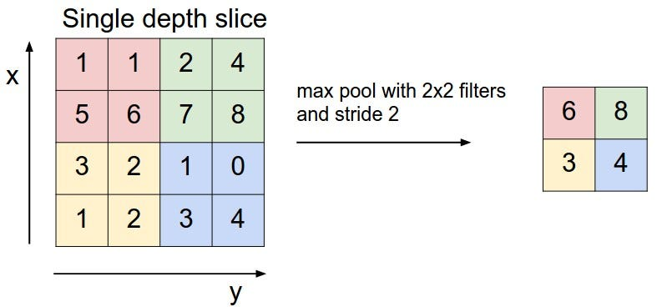
Convolutions and pooling help learn unique features just like our brain!

Slide 8
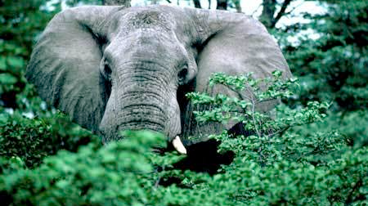
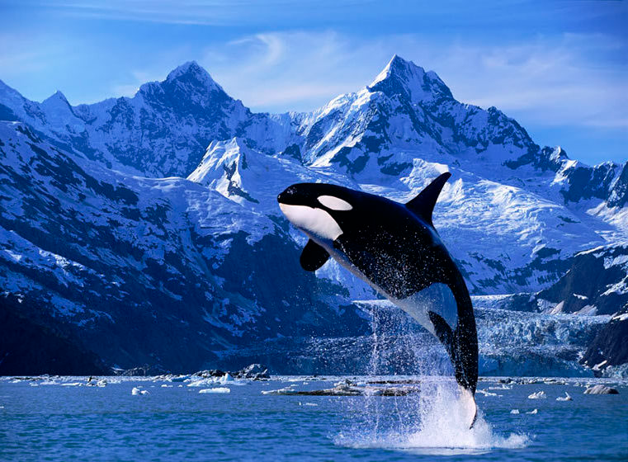

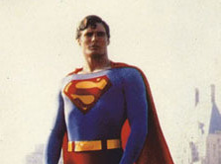
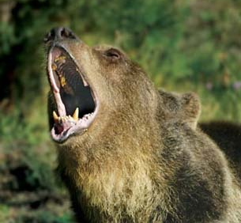
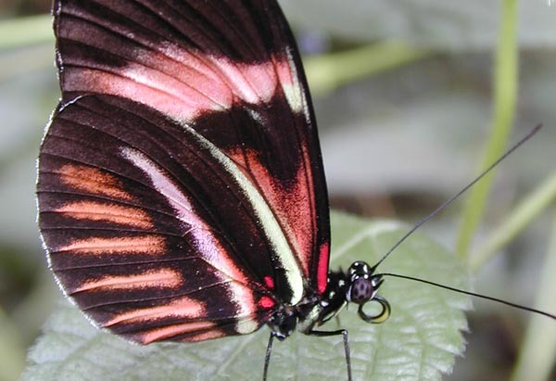
Image Recognition task: Caltech 256 dataset [9]
Subset of 46/257 classes used
Animals, people, and superman

Slide 9
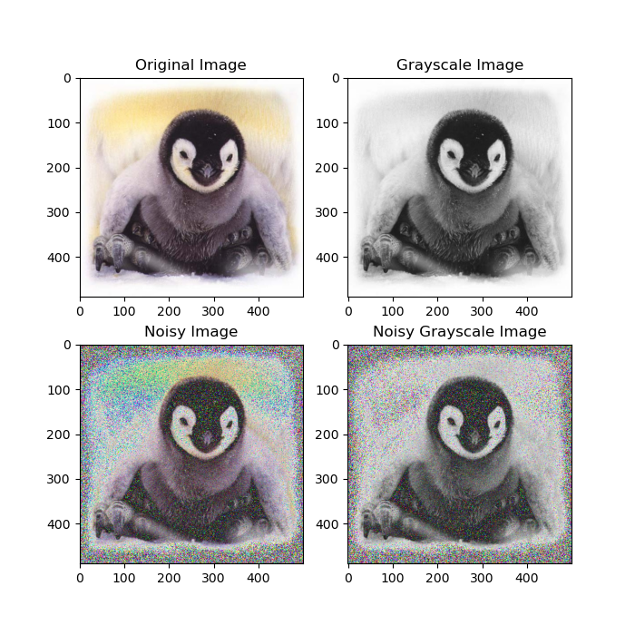
Image Augmentation Simulation Study
Questions:
How does the performance of a standalone deep neural network (DNN) compare to that of a CNN?
What changes in model performance are there when images in the training dataset are gray scale as opposed to in color?
How does random noise affect model performance? Is this affect parallel for both a DNN and a CNN? For color vs. gray-scale images?

Slide 10
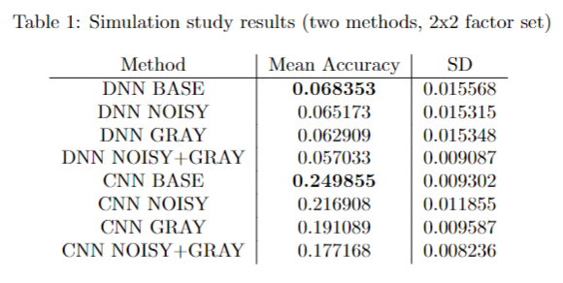
Image Augmentation Simulation Study
20 simulations

Slide 11
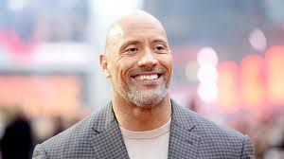
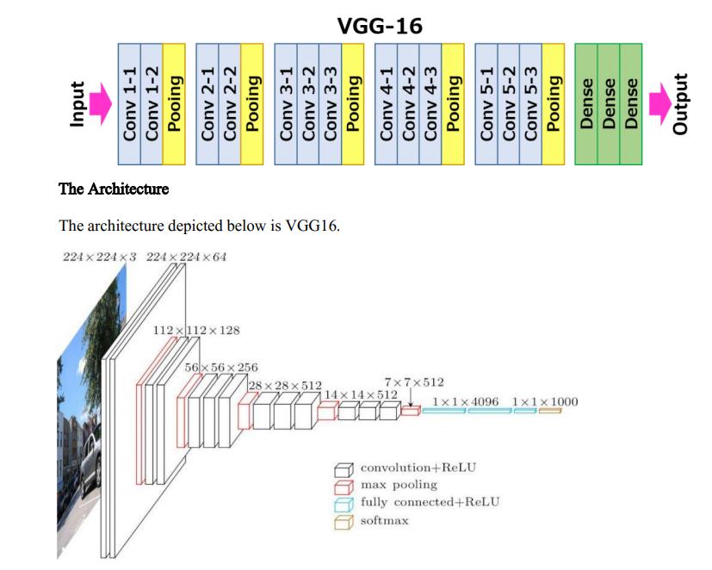
“Try something smarter”: Deep CNNs
CNN with 4 convolutional/pooling layers
Borrowing strength from 16-layer CNN trained on 14 million images: VGG16
Image credit: Tanmay Thaker [21]

Slide 12
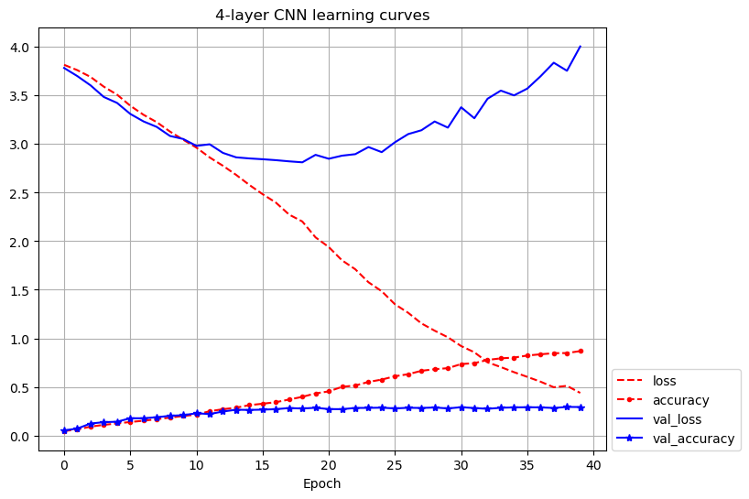
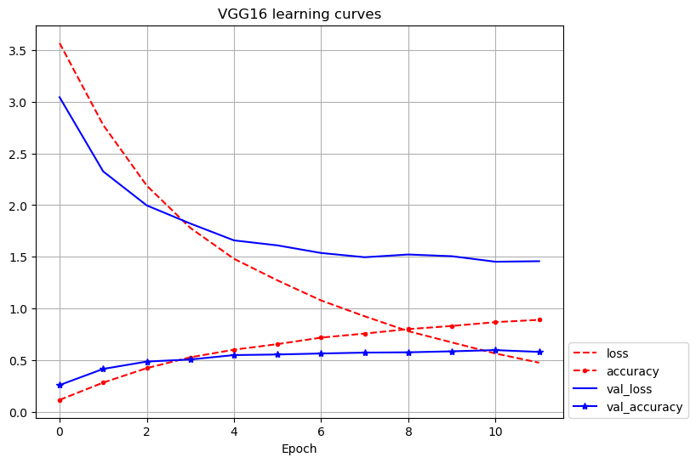
“When you do the right thing, you’ll get a better answer”
4-layer network marginally improved performance
Deeper VGG16 network pretrained on more images gave 20%+ improvement to performance

Slide 13
Conclusions
Learning spatial structure of images (CNN) drastically aids performance compared to simple deep neural network (DNN)
Diminishing returns for CNN as images become noisier or lack color
Not as much drop off for DNNs, but slightly more variance in predictions
Deeper networks improve performance proportional to image variety and quantity available in training data

Slide 14
References
[1] J. Brownlee. How do convolutional layers work in deep learning neural networks?, Apr 2020. [2] J. Brownlee. How to improve deep learning model robustness by adding noise, Aug 2020. [3] J. Brownlee. How to choose an activation function for deep learning, Jan 2021. [4] R. Chow. Imagenet: A pioneering vision for computers, Mar 2022. [5] Comidor. 6 use cases of image recognition in our daily lives: Comidor, Nov 2022. [6] K. D. Foote. A brief history of deep learning, Feb 2022. [7] A. Geron. Hands-On Machine Learning with Scikit-Learn, Keras, and TensorFlow: Concepts, Tools, and Techniques to Build Intelligent Systems. O’Reilly Media, Inc., 2nd edition, 2019. [8] R. Gomez. Understanding categorical cross-entropy loss, binary cross-entropy loss, softmax loss, logistic loss, focal loss and all those confusing namesr, May 2018. [9] G. Griffin, A. Holub, and P. Perona. Caltech 256, Apr 2022. [10] S. N. Gupta. Deep convolutional neural networks (dcnns) explained in layman’s terms, Feb 2022. [11] C. Kanan and G. Cottrell. Color-to-grayscale: Does the method matter in image recognition? PloS one, 7:e29740, 01 2012. [12] A. Krizhevsky, I. Sutskever, and G. E. Hinton. Imagenet classification with deep convolutional neu- ral networks. In F. Pereira, C. Burges, L. Bottou, and K. Weinberger, editors, Advances in Neural Information Processing Systems, volume 25. Curran Associates, Inc., 2012. [13] M. Mazur. A step by step backpropagation example, Aug 2022. [14] D. Nielsen. Deep learning cage match: Max pooling vs convolutions, Sep 2018. [15] M. A. Nielsen, Dec 2019. [16] K. Simonyan and A. Zisserman. Very deep convolutional networks for large-scale image recognition, 2015. [17] T. Wood. Activation function, Sep 2020.
Other references (for images):
[18] https://medium.com/aiguys/deep-convolutional-neural-networks-dcnns-explained-in-layman-terms-b990b2818061
[19] https://en.wikipedia.org/wiki/Face_ID
[20] https://www.tomsguide.com/how-to/how-to-use-visual-look-up-in-ios-15
[21] https://medium.com/nerd-for-tech/vgg-16-easiest-explanation-12453b599526
[22] Tass, Shannon. Class Slides, STAT 486, 2023.
[23] Output from ChatGPT for helpful ideas on simple ways to explain complex principles

